Slide 1
IMAGE SEGMENTATION FOR FLOWER CLASSIFICATION DATASET USING DEEP LEARNING METHODS

Slide 2
Introduction
Goal:
Aim is to build two models for image segmentation that segments flower from varied background.
One approach should be pre-trained model and other should be custom model.
Dataset :
The input is Oxford Flower dataset that has 17 class and 80 images for each class. Total of 1360 flower images each with corresponding label images. I have been provided with two files : image file which has flower images and label file which contains segmentation maps for each flower.
I defined pixel label id as 1 for flower and 3 for background.

Slide 3
Data Pre-processing
Un-Annotated Images:
I removed the annotated images using a custom function that matched the names in both files and then copied the matched images to a new folder
Gaussian Filter:
The Gaussian filter as a technique used for smoothing, noise reduction, and feature extraction in images.
It is a mathematical function that applies a weighted average to neighboring pixels, with more weight given to nearby pixels.

Slide 4
Pre-trained model : U-Net
U-Net:
The U-Net architecture follows an encoder-decoder structure.
The encoder part consists of several convolutional layers followed by max-pooling layers, which reduces the spatial dimensions of the input image while increasing the number of feature channels.
The decoder part consists of up-sampling layers followed by convolutional layers, which gradually increase the spatial dimensions while decreasing the number of feature channels. The up-sampling layers help to recover the spatial information lost during the encoding stage.
One of the key features of the U-Net architecture is the skip connections, it connect the corresponding layers between the encoder and decoder parts of the network which allows the decoder to access feature maps from the encoder.

Slide 5
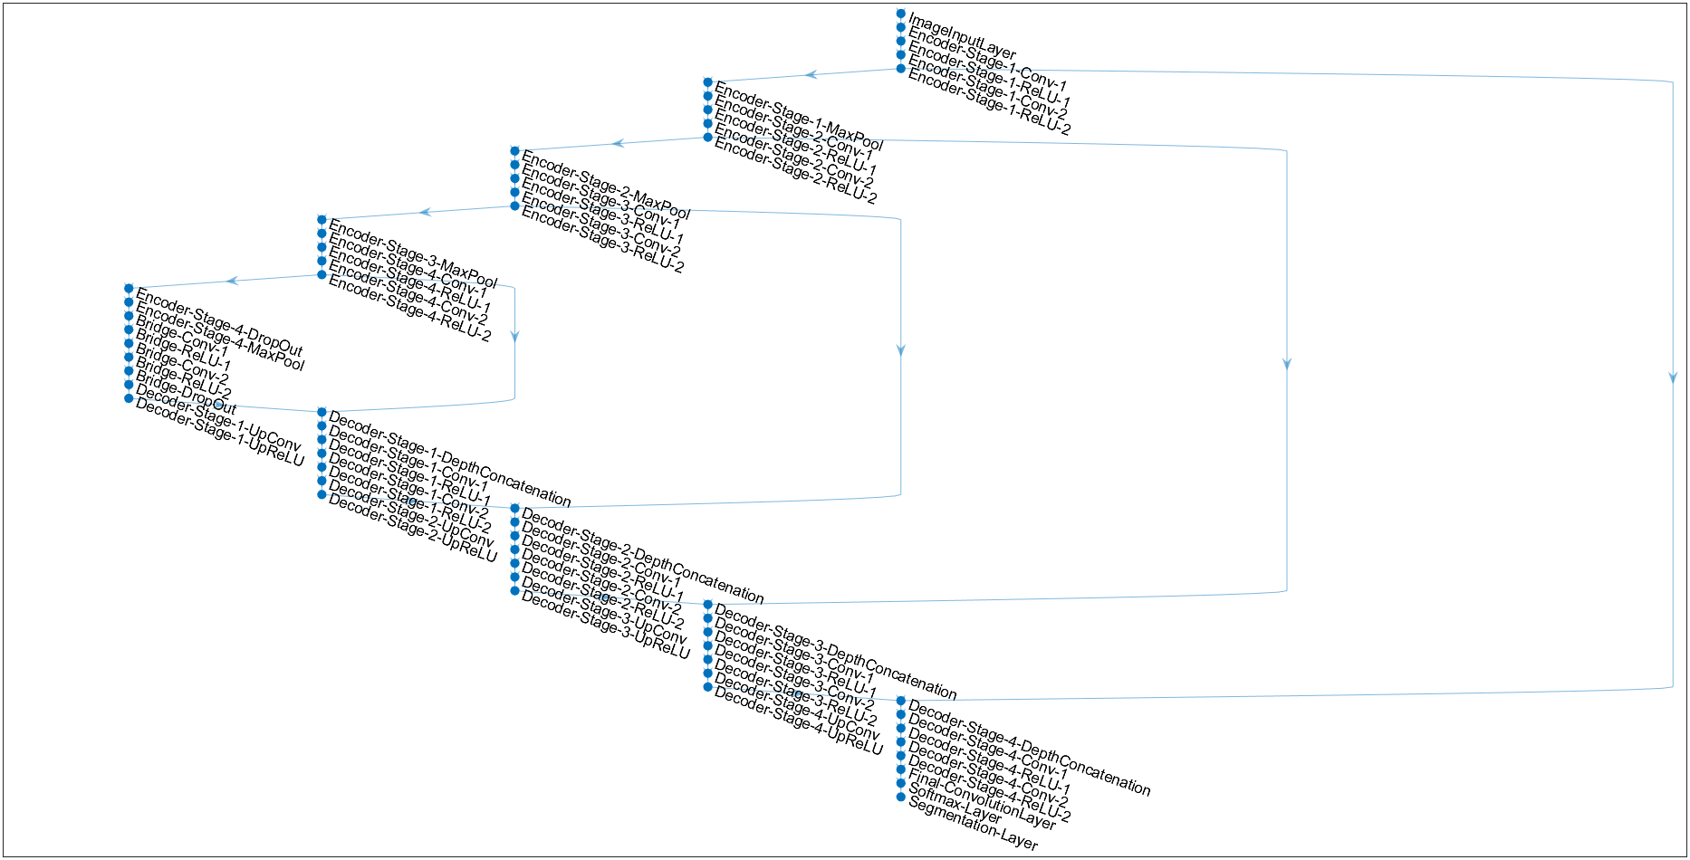
Architecture of U-Net layer
Figure 1 Architecture of U-Net Model

Slide 6
Custom Model
Custom Model:
The custom model is in four steps.
In first step, I defined the input layer which is 256x256 pixels (Input size).
Next step, I built the downsampling and upsampling layers, explained briefly in next slide.
In the third step, I defined the final layers using a convolutional layer, softmax layer and PixelClassificationLayer.
Finally I stacked all these layers and set the training options for the during training phase. I chose ‘adam’ as optimizer, learning rate as 0.001, max epochs as 10 and mini batch size as 128.

Slide 7
Custom Model
Downsampling Layer
Upsampling Layer
Downsampling decreases the size of the input image while simultaneously enhancing the number of extracted filters.
Each block the number of filters increases progressively, from 64 to 256.
Downsampling layer consist of 3 block, each block include convolutional operations with 3x3 filters and ReLU activation, followed by max pooling to reduce spatial dimensions. Batch normalization layer is applied to stabilize training by normalizing layer activations.
Upsampling enlarges the spatial dimensions of the input image, aiming to restore the lost spatial information incurred during downsampling and recreate the initial resolution of the input.
Similar to downsampling, upsampling consists of 3 block. Each block consists of transposed convolutional layer, Batch normalization and ReLU activation function. In each block the number filters reduces progressively from 256 to 64 filters.

Slide 8
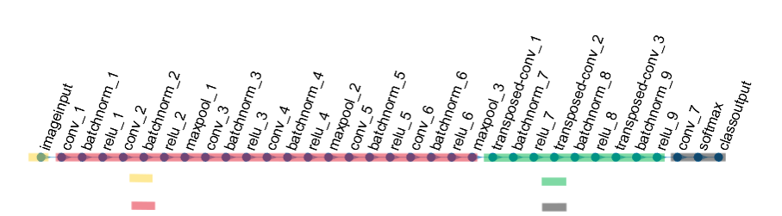
Architecture of Custom Model.
: Input layer
: Upsampling layer
: Downsampling layer
: Final layer
Figure 2 Architecture of Custom Model.

Slide 9
Evaluation
To evaluate the model I used standard metrics such as accuracy, confusion matrix, Intersection over Union and Mean Boundary F1 Score.
Table 1 Evaluation results of both models.
We can clearly observe in Table 1that custom model out performed the pre-trained(U-Net) model in every score.
Model | Global Accuracy | Mean Accuracy | Mean IoU | Mean Boundary F1 score
U-Net Model | 0.8986 | 0.8774 | 0.7918 | 0.5539
Custom Model | 0.9567 | 0.95365 | 0.9062 | 0.8386

Slide 10
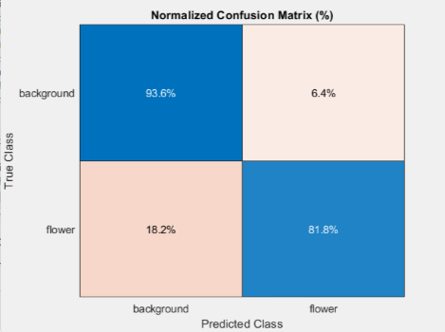
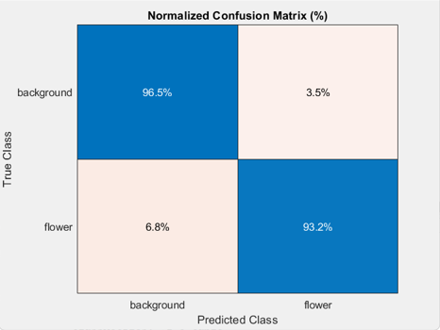
Evaluation metric : Confusion matrix
U-Net model
Custom model
The figure 1 shows the confusion metric score of U-Net model.
Figure 2 shows the confusion metric score of my custom model.
Figure 3 Confusion matrix for U-Net model
Figure 4 Confusion matrix for custom model
The Custom Model is more effective at classifying both background and flowers compared to the U-Net Model, as evidenced by its higher true positive rates and lower false positive rates.

Slide 11
Conclusion
In summary, the Custom Model outperforms the U-Net Model in all evaluated metrics, demonstrating enhanced precision in segmenting flower from the varied backgrounds.
Its superior accuracy and lower rate of misclassification make it highly suitable for applications demanding precise segmentation of objects.

Slide 12
Experimental Setup : - Technology Stack
Programming Environment
PySpark: Utilized for handling large-scale data processing. It uses distributed computing across multiple nodes to handle the data and process it parallel.
Libraries and Metrics
spaCy: Natural Language Processing (NLP) library used for text preprocessing and analysis.
Transformers: Leveraged for utilizing pre-trained NLP models and summarization tasks.
Rouge: To evaluate the quality of text summaries against a set of reference summaries.

Slide 13
What i am going to speak.
let us look into the technology and libraries needed for our project.
Pyspark: We require pyspark environment because it uses apache and spark framework, which is designed for distributed computing. This allows you to distribute data across multiple nodes in a cluster and process it in a parallel. This distributed approach enables efficient processing of large datasets by utilizing the computing power of multiple machines.
Then lets look into the libraries now
Spacy: We used spacy library , which is powerful NLP library which excels in efficient and accurate text processing.
Transformer : This model can weigh the importance of different words in a sentence when pre-processing each word. it can process words in parallel, making them more efficient for handling long sequence text.
Rogue: To evaluate our model, we used rogue metric, it stands for Recall-Oriented Understudy for Gisting Evaluation. Its goal is to measure the overlap between the words, phrases in the generated summary and those in the reference summaries.

Slide 15
THANK YOU

